Slide 1


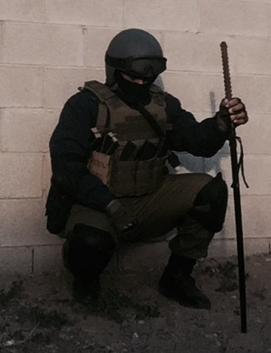
The Team
Who are the data collectors
What do they do
Where do they work
Why do they do it

Slide 2

Life in the Field
Developers followed a data collection team around for three days to observe their daily activities.
Their working environment
Daily activities
Data collection
Risks
Necessary precautions
Equipment

